Slide 1
Balancing Life Domains
A COACHING MASTERCLASS

Slide 2
Today
Chapter 1: Life Domains (Water)
Chapter 2: Life Balance
Chapter 3 Life Domain Satisfaction
Chapter 4: Need Satisfaction
Chapter 5: Activities per Life Domain
Chapter 6: Summary

Slide 3
1
Life Domains
(water)

Slide 4
Life domains
Chapter 1 – Life Domains (water)
first element of sailboat
starting point of interventions

Slide 5
Core question
Chapter 1 – Life Domains (water)
?
“What are the individual’s most important life domains?”

Slide 6

Life domains
Chapter 1 – Life Domains (water)
different aspects of life
“segments” of reality
e.g. health, friends, leisure-time, work, family

Slide 7
Life domains
Chapter 1 – Life Domains (water)
The most frequently addressed life domains in research are:
health
family
income
relationships
work
sex life
housing
safety
self-worth
education

Slide 8

Sailboat metaphor
Chapter 1 – Life Domains (water)

Slide 9
Practical benefits
Chapter 1 – Life Domains (water)
more complete picture of client’s life
wider range of options for finding valuable resources and solutions
widen scope of the client's self-definition

Slide 10
Practical advice
Chapter 1 – Life Domains (water)
at least 173 different domain names (Cummins, 1996)
meaning may differ per individual
ask the client to generate the names of domains rather than
pre-made list

Slide 11
Your most important life domains
Chapter 1 – Life Domains (water)
9
Choose up to 10 of the most important domains in your life.

Slide 12
Interconnection
Chapter 1 – Life Domains (water)
a change in one life domain may influence or coincide with a change in another life domain (e.g. divorce - unemployment)
work-family enrichment: e.g skills at home → work

Slide 13
Campbell et al. (1976)
Chapter 1 – Life Domains (water)
How important is this life domain to you?
US Americans
similar findings in 28 European countries (Delhey, 2004)

Slide 14
2
Life Balance
(water - attention)

Slide 15
The Captain: Attention
Chapter 2 – Life Balance (water - attention)

Slide 16
Core question
Chapter 2 – Life Balance (water - attention)
?
“To what extent is there a balanced amount of attention for the different life domains?”

Slide 17
Niven (2000, p. 71)
Chapter 2 – Life Balance (water - attention)
”
“Your life is made up of many different facets. Don’t focus on one aspect of your life so much that you can’t experience pleasure if that one area is unsettled.”

Slide 18
Research findings
Chapter 2 – Life Balance (water - attention)
the ability to balance life demands has been found to be positively related to:
life satisfaction
marital satisfaction
mental health

Slide 19
Research findings
Chapter 2 – Life Balance (water - attention)
failing to achieve a balance across life domains is associated with:
higher stress
health problems
family conflict
overall decrease in well-being and quality of life

Slide 20

Why life balance?
Chapter 2 – Life Balance (water - attention)
perceived importance of life
domains changes during life
amount of satisfaction that can be derived from a single life domain is limited

Slide 21

Sailboat metaphor
Chapter 2 – Life Balance (water - attention)
insufficient navigation to other parts of the water
one-sided journey

Slide 22

Sailboat metaphor
Chapter 2 – Life Balance (water - attention)
regularly adjusting course of boat
enjoying the beauty of the whole ocean

Slide 23
Life domain diagrams
Chapter 2 – Life Balance (water - attention)
10

Slide 24
3
Life Domain Satisfaction
(water - thoughts)

Slide 25
The captain: Thoughts
Chapter 3 – Life Domain Satisfaction (water – thoughts)

Slide 26
Core question
Chapter 3 – Life Domain Satisfaction (water – thoughts)
?
“How satisfied is the individual in each of their different life domains?”

Slide 27
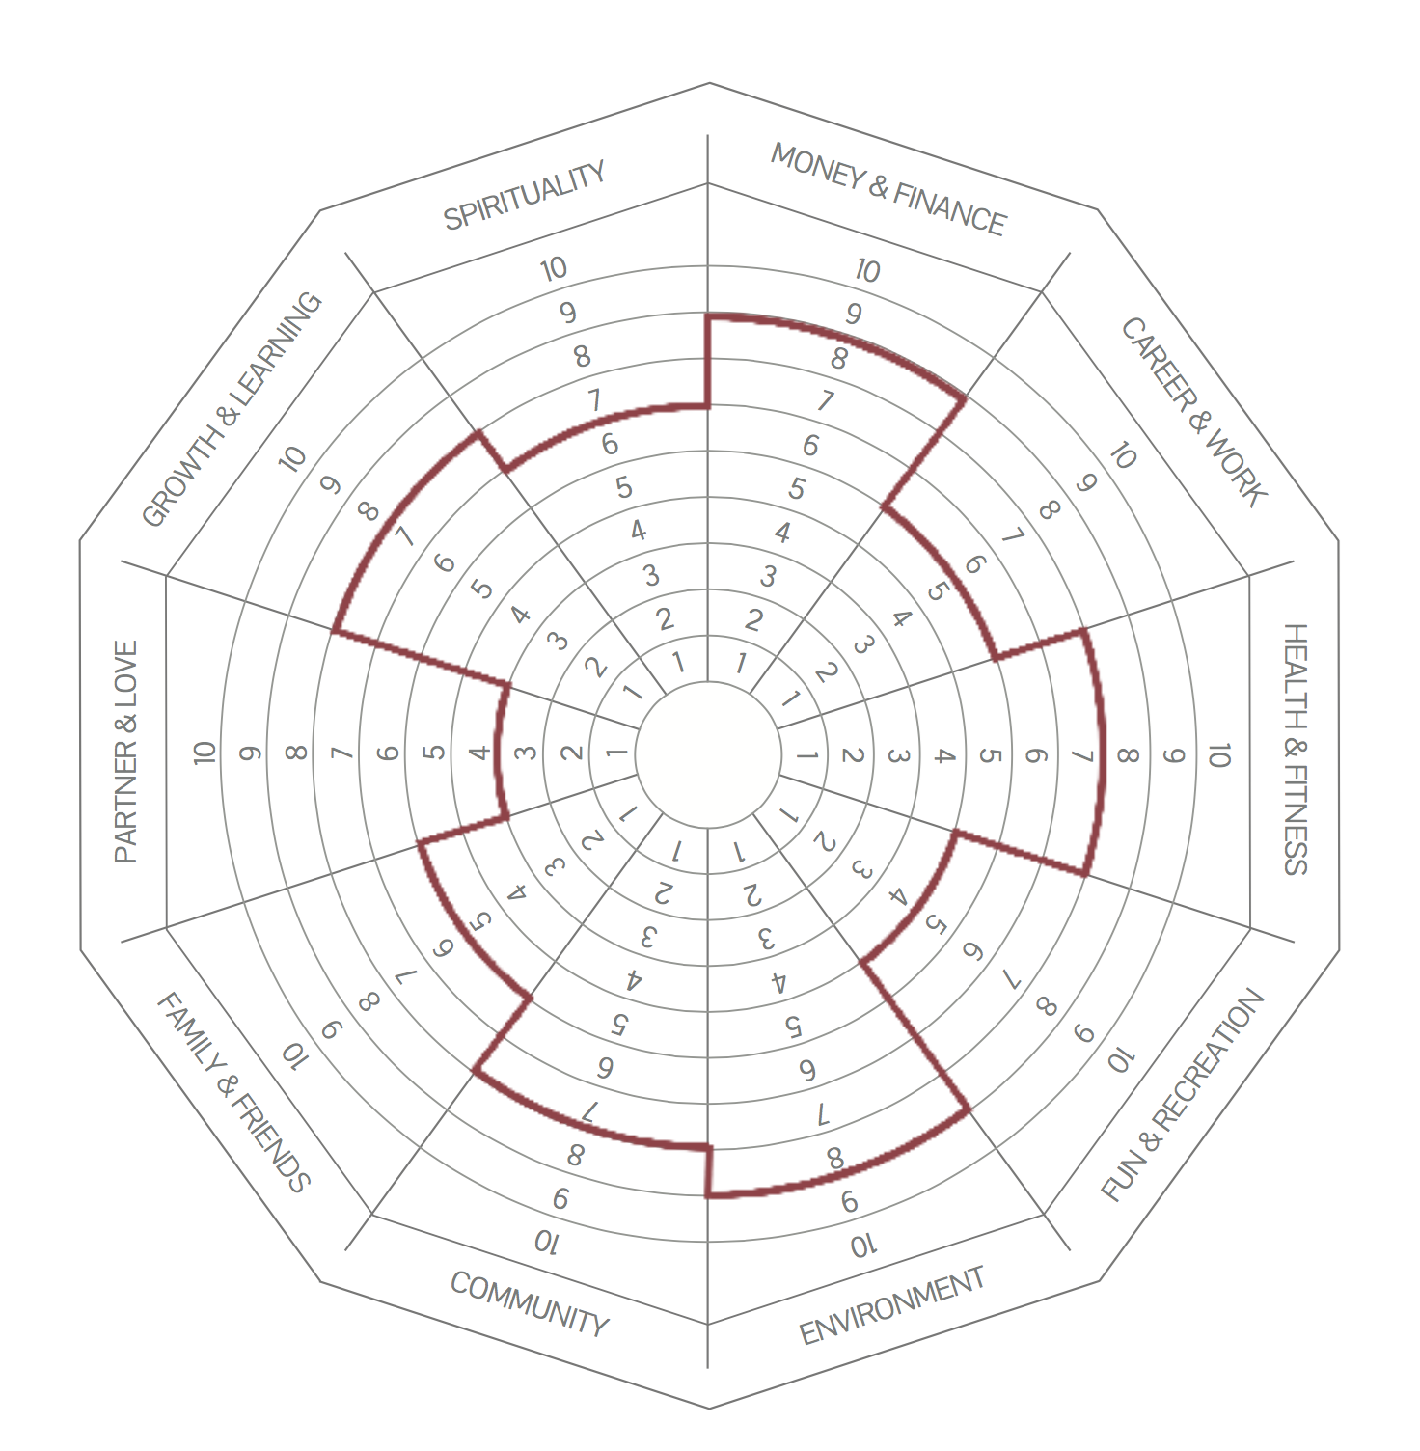
Wheel of Life
Chapter 3 – Life Domain Satisfaction (water – thoughts)
12
enter the names of life domains in the outer rim of the Wheel of Life.
rate level of satisfaction in each of the domains (0-10).
connect the lines to form an inner wheel
in pairs, discuss the insights from this exercise

Slide 28
Weighted satisfaction score?
Chapter 3 – Life Domain Satisfaction (water – thoughts)
Weighted satisfaction score does not seem to have any advantages in predicting global satisfaction over unweighted scores:
accurate assessment of importance is difficult/arbitrary
life domains are highly connected

Slide 29
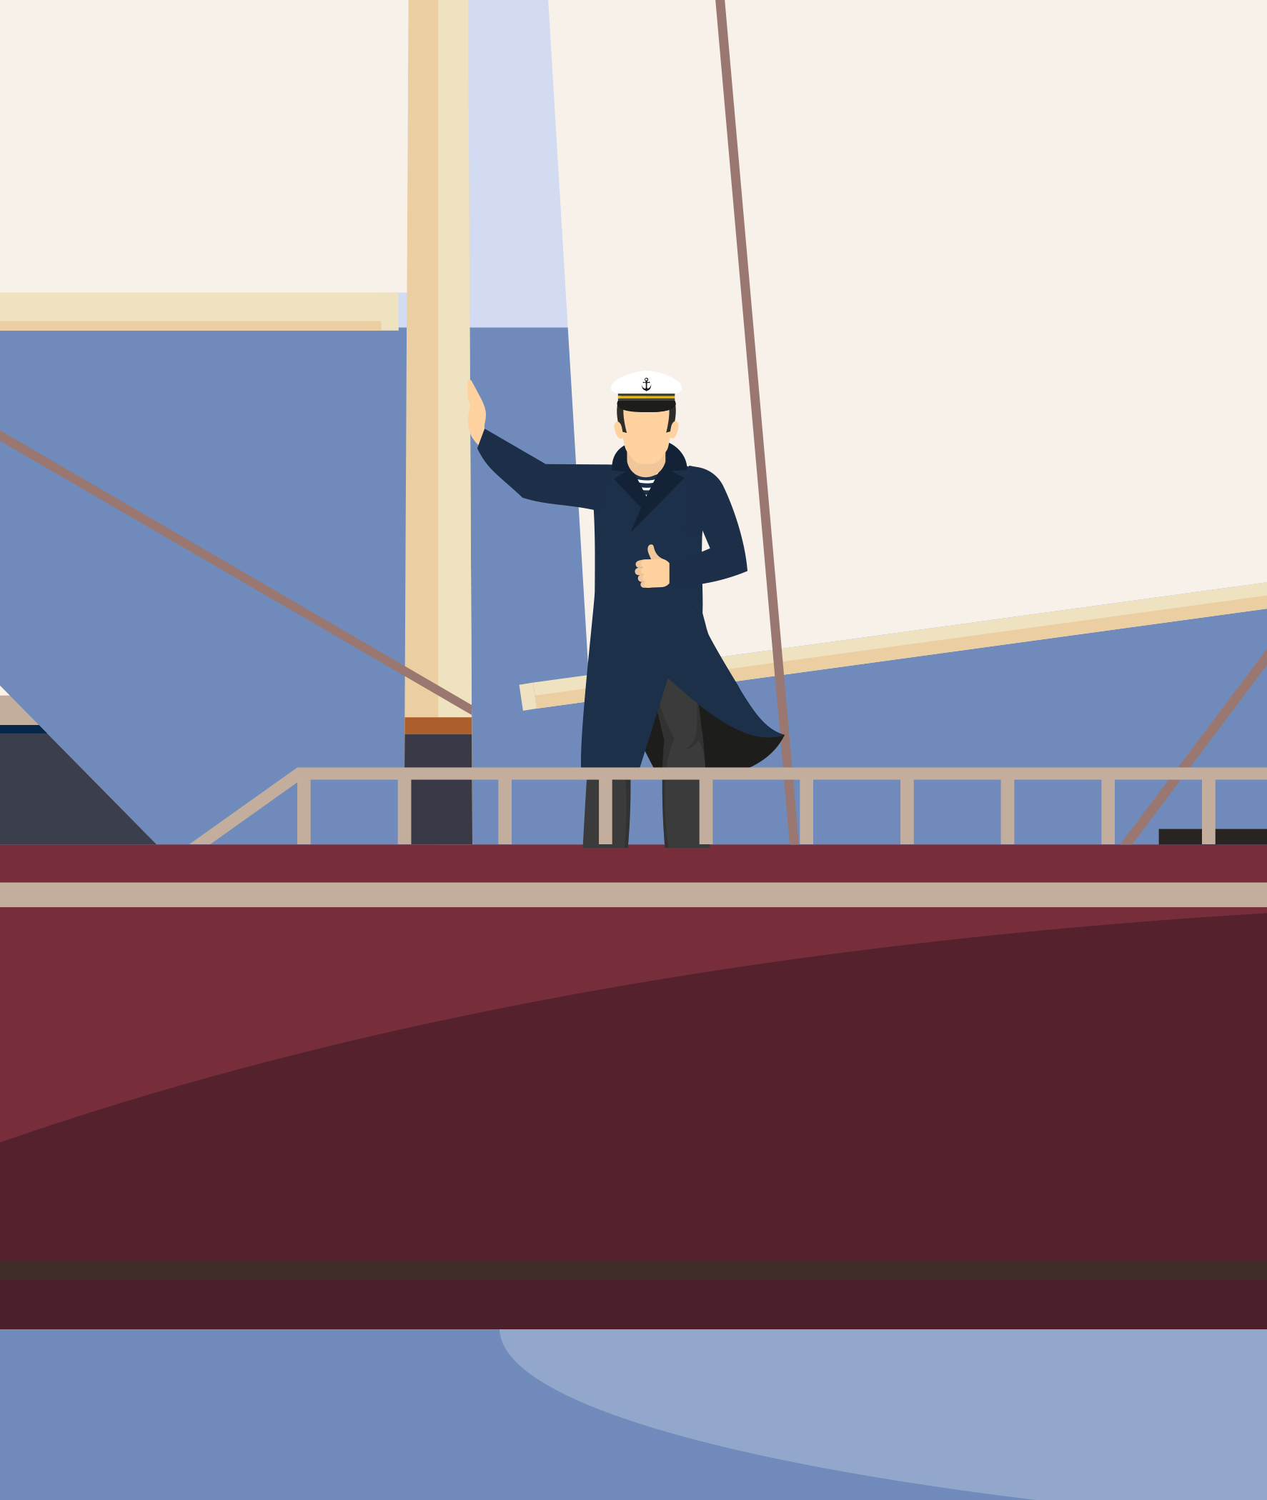
Sailboat metaphor
Chapter 3 – Life Domain Satisfaction (water – thoughts)
the evaluative thoughts of the captain while sailing on a particular area of the sea

Slide 30
4
Need Satisfaction
(water - motivation)

Slide 31
The captain: Motivation
Chapter 4 – Need Satisfaction (water – motivation)

Slide 32
Core question
Chapter 4 – Need Satisfaction (water – motivation)
?
“Which needs are being satisfied through the activities in each life domain?”

Slide 33
Deci & Ryan (2003, p. 229)
Chapter 4 – Need Satisfaction (water – motivation)
”
“…[psychological] needs specify innate psychological nutriments that are essential for ongoing psychological growth, integrity, and well-being.”

Slide 34
Needs
Chapter 4 – Need Satisfaction (water – motivation)
people are motivated to fulfil needs (e.g. autonomy, relatedness)
more successful need satisfaction = more life satisfaction
life domains are organised and structured around several needs

Slide 35

Example of needs per life domain
Chapter 4 – Needs (water – motivation)

Slide 36
Need satisfaction limits
Chapter 4 – Needs (water – motivation)
subjective well-being is not simply the result of positive minus negative affect
satisfaction from one life domain can contribute only a limited amount of positive affect to subjective well-being
overinvestment in one life domain = thwarting of needs

Slide 37
5
Activities per Life Domain
(water - action)

Slide 38
The captain: Action
Chapter 5 – Activities per Life Domain (water – action)

Slide 39
Core question
Chapter 5 – Activities per Life Domain (water – action)
?
“What kind of behaviour is required to increase life balance and satisfaction across life domains?”

Slide 40
Activities per life domain
Chapter 5 – Activities per Life Domain (water – action)
LIFE DOMAIN
ACTIVITY
ACTIVITY
ACTIVITY
ACTIVITY

Slide 41
Activities per life domain
Chapter 5 – Activities per Life Domain (water – action)
HEALTH
CYCLING
HEALTHY COOKING
REST
MEDICAL CHECKUPS

Slide 42

Important note
Chapter 5 – Activities per Life Domain (water – action)
many activities serve multiple life domains at the same time

Slide 43
Types of behavioral change
Chapter 5 – Activities per Life Domain (water – action)
1. redistribution of time
LIFE DOMAIN
LIFE DOMAIN A
LIFE DOMAIN B
ACTIVITY
ACTIVITY
ACTIVITY
ACTIVITY
ACTIVITY
ACTIVITY
ACTIVITY
ACTIVITY
ACTIVITY
ACTIVITY
ACTIVITY
ACTIVITY

Slide 44

Sailboat metaphor
Chapter 5 – Activities per Life Domain (water – action)

Slide 45
Types of behavioral change
Chapter 5 – Activities per Life Domain (water – action)
2. increasing priority; too many different activities
LIFE DOMAIN
ACTIVITY
ACTIVITY
ACTIVITY
ACTIVITY
ACTIVITY
ACTIVITY
ACTIVITY
ACTIVITY
ACTIVITY
ACTIVITY
ACTIVITY
ACTIVITY
ACTIVITY
ACTIVITY
ACTIVITY
ACTIVITY
ACTIVITY
ACTIVITY
ACTIVITY
ACTIVITY
ACTIVITY

Slide 46

Sailboat metaphor
Chapter 5 – Activities per Life Domain (water – action)

Slide 47
Types of behavioral change
Chapter 5 – Activities per Life Domain (water – action)
3. acting with more awareness
LIFE DOMAIN A
LIFE DOMAIN B
ACTIVITY
ACTIVITY
ACTIVITY
ACTIVITY
ACTIVITY
ACTIVITY
ACTIVITY
ACTIVITY
ACTIVITY
ACTIVITY
ACTIVITY
ACTIVITY
ACTIVITY
ACTIVITY
ACTIVITY
ACTIVITY

Slide 48

Sailboat metaphor
Chapter 5 – Activities per Life Domain (water – action)

Slide 49
Required action
Chapter 5 – Activities per Life Domain (water – action)
14
Take a look at the results from the Wheel of Life and the Life Domain Diagrams.
Which life domain needs the most attention right now?
Which action(s) may be required in this life domain?

Slide 50
6
Summary

Slide 51
Today
Chapter 6 – Summary

Slide 52
Thanks
for your attention

